Slide 1
British Airlines Reviews
Web scraping to gain company insights

Slide 2
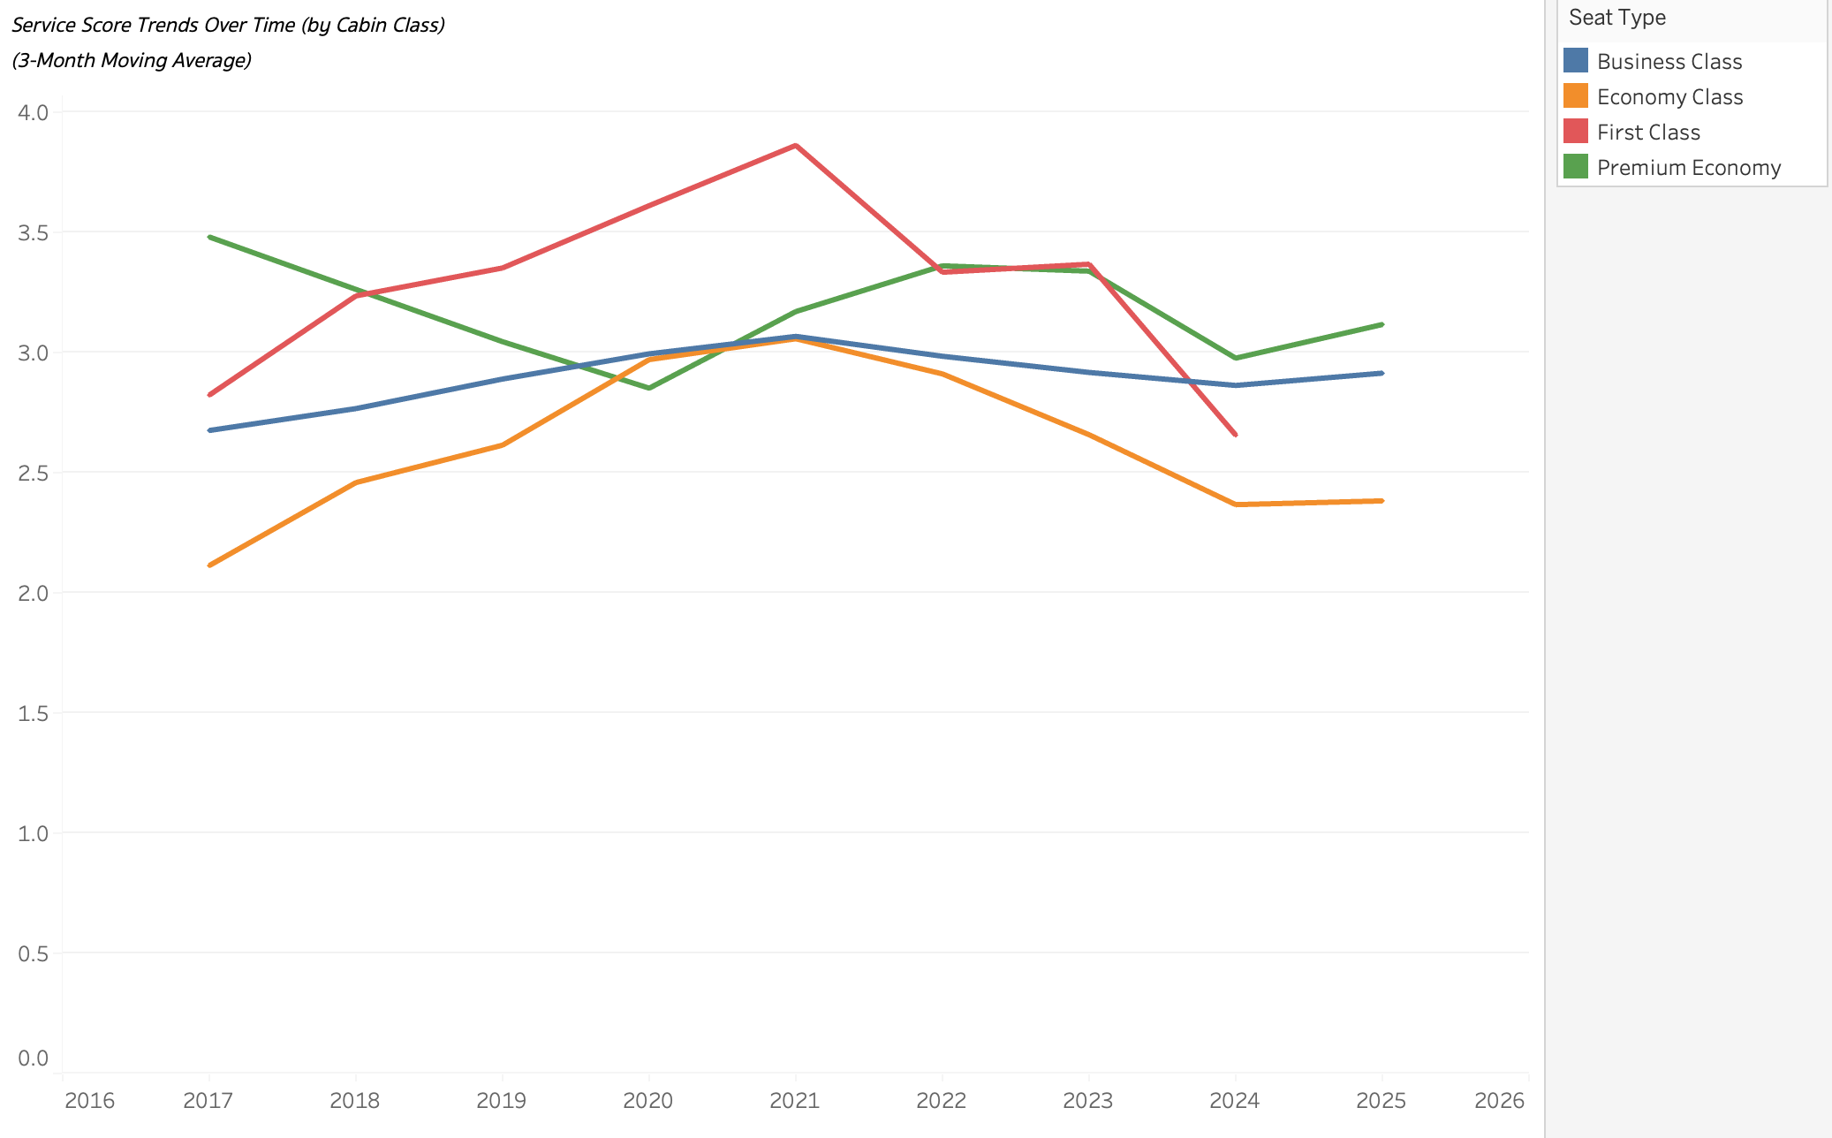
Route & Service Performance Insights
Metric | Value
Top Destination | London
Recommendation Rate | 33,92%
Best Value for Money | Solo Leisure
Best Seat Comfort | First Class
Best Food & Beverages | First Class
Positive Sentiment | 49.2%
Negative Sentiment | 48.9%
Recommendations
Service & Operations
Deep-dive into Economy Class pain points: seat comfort, food, staff attentiveness
Launch service recovery tactics (apology vouchers, feedback loops)
Train cabin/ground staff, especially before peak months (June–Sept)
Marketing & Targeting
Promote Premium Economy as “Smart Upgrade” — especially for Solo Leisure travellers
Showcase First Class excellence in campaigns to elevate brand prestige
Target Solo Leisure segment — highest recommendation score (2.7)
Analytics & Monitoring
Keep tracking year-over-year service trends to measure progress
Monitor complaint categories monthly — align initiatives to complaint volumes
Insights & Trends
Economy Class shows flat service score trends — major concern for long-term loyalty
Premium Economy is improving steadily — opportunity for targeted upselling
Business Travelers are least satisfied (score: 2.0) — likely due to higher expectations
Complaints are most frequent in Service, Food, and Comfort categories
Negative sentiment spikes mid-year (summer) and year-end — aligns with peak travel stress

